Slide 1



PRISMS Center Center for PRedictive Integrated Structural Materials Science
CASM Demo – Day 1
John C. Thomas, Brian Puchala, Anton Van der Ven Anirudh Natarajan, John Goiri, Min-Hua Chen, Max Radin, Jonathon Bechtel, Elizabeth Decolvenaere
PRISMS Center Workshop
August 15-17, 2016
Website: prisms-center.org

Slide 2
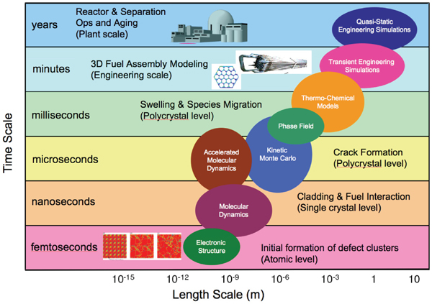
A persisting problem
Source: http://www.lbl.gov/cs/html/exascale4energy

Slide 3
A persisting problem
Source: http://www.lbl.gov/cs/html/exascale4energy

Slide 4
From atoms to microns
Calculate accurate energies of the system in 10²-10³ different states

Slide 5
From atoms to microns
Solve
better than ~10 meV/atom
Calculate accurate energies of the system in 10²-10³ different states
Chemical species
Charge states
Atomic displacement
Strain

Slide 6
From atom- to micron-scale
Identify suitable variables and basis functions for parameterizing energy model
Calculate accurate energies of the system in 10²-10³ different states

Slide 7
From atom- to micron-scale
Unknown
Must be invariant to symmetry!!
Identify suitable variables and basis functions for parameterizing energy model
Calculate accurate energies of the system in 10²-10³ different states

Slide 8
From atom- to micron-scale
Use model for material optimization or to simulate material properties
Identify suitable variables and basis functions for parameterizing energy model
Calculate accurate energies of the system in 10²-10³ different states

Slide 9
From atom- to micron-scale
Free energy
Phase diagrams
Elastic tensors
Thermal conductivity
Diffusivity
Vibrational spectra
As a function of temperature, stress, chemical potential, etc.
Use model for material optimization or to simulate material properties
Identify suitable variables and basis functions for parameterizing energy model
Calculate accurate energies of the system in 10²-10³ different states

Slide 10
From atom- to micron-scale
Share data with colleagues for experimental design or simulation at longer length/time scales
Use model for material optimization or to simulate material properties
Identify suitable variables and basis functions for parameterizing energy model
Calculate accurate energies of the system in 10²-10³ different states

Slide 11
From atom- to micron-scale
Share data with colleagues for experimental design or simulation at longer length/time scales
Use model for material optimization or to simulate material properties
Identify suitable variables and basis functions for parameterizing energy model
Calculate accurate energies of the system in 10²-10³ different states
Construct structural hypotheses of what happens in the real material

Slide 12
From atom- to micron-scale
Share data with colleagues for experimental design or simulation at longer length/time scales
Use model for material optimization or to simulate material properties
Identify suitable variables and basis functions for parameterizing energy model
Calculate accurate energies of the system in 10²-10³ different states
Construct structural hypotheses of what happens in the real material

Slide 13
CASM Tutorial Outline
Today:
Crystal structure identification & specification
Symmetry analysis
Using CASM to manage data
Configuration selections and query syntax
Maintaining sanity with cluster expansion profiles
Cluster expansion basics
Configuration enumeration
Cluster expansion basis sets & correlation evaluation
Tomorrow (with Brian Puchala):
Parameterizing cluster expansions
Predicting thermodynamic properties with grand canonical Monte Carlo
Free energy integration and phase diagram construction

Slide 14
CASM: Clusters Approach to Statistical Mechanics
First-principles energies of a “few” excitations
Extrapolate to
all other excitations
Lattice Model Hamiltonian
Monte Carlo
Thermodynamics

Slide 15
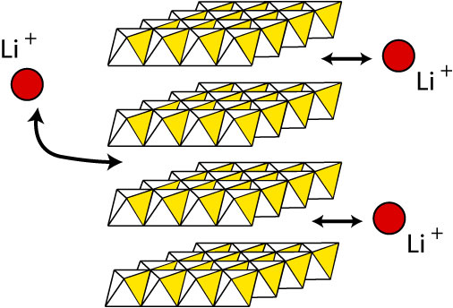
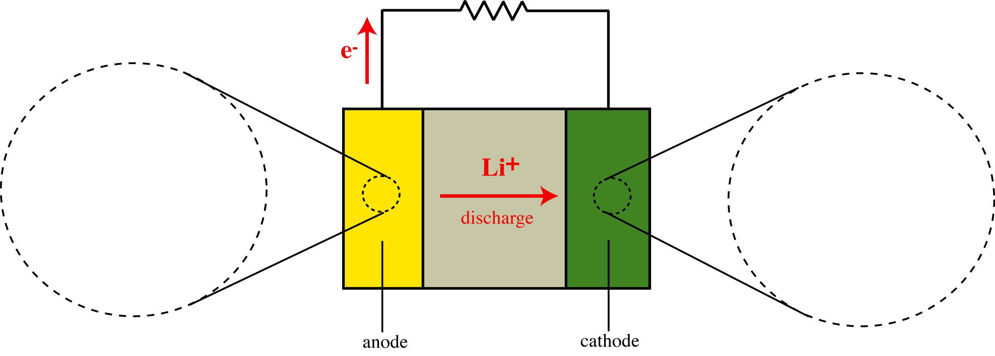
Lithium ion batteries
Li
Li_{x}M
Li_{x}CoO₂ Li_{x}TiS₂ Li(Ni_{0.5}Mn_{0.5})O₂

Slide 16
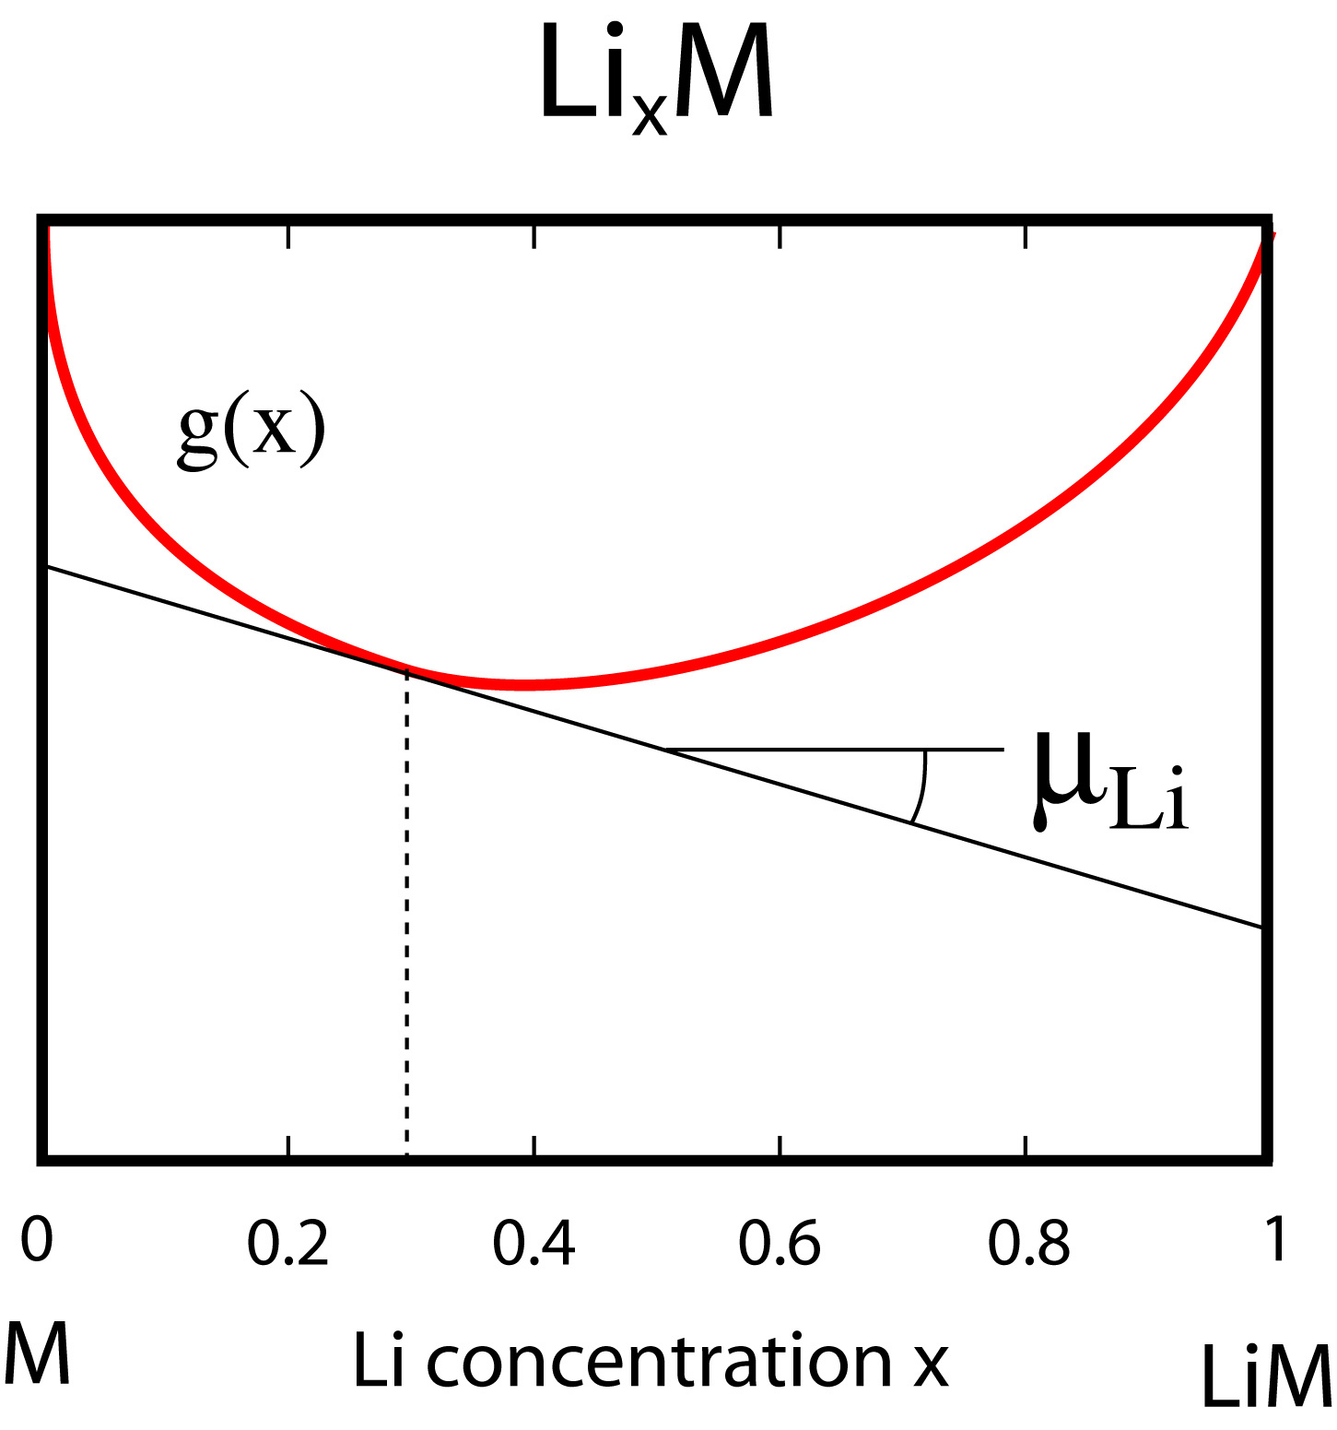
Electrochemical measurements and thermodynamics
Gibbs free energy
Li
Li_{x}M

Slide 17
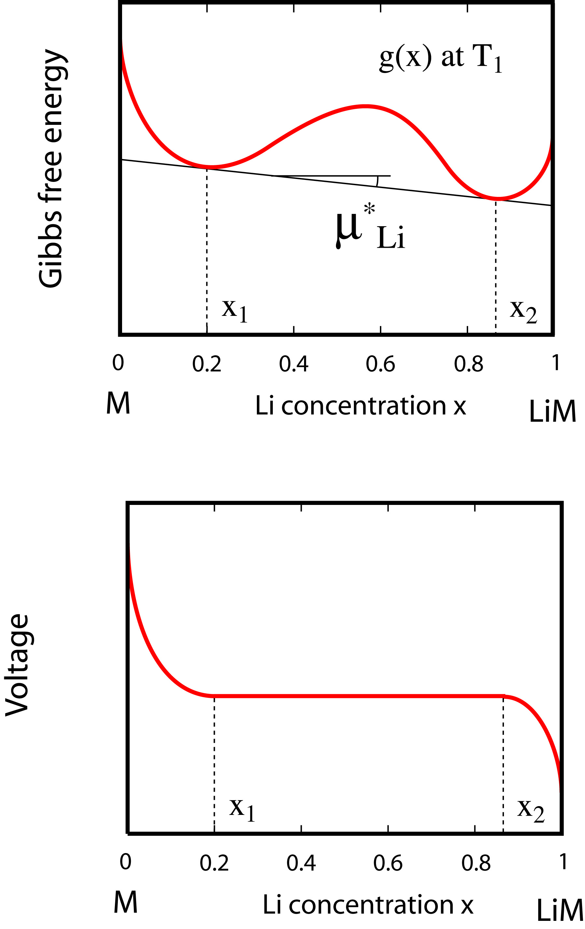
Electrochemical measurements and thermodynamics

Slide 18
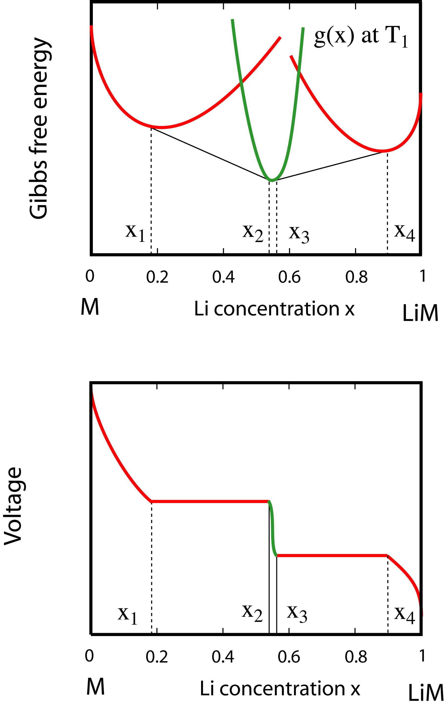
Electrochemical measurements and thermodynamics

Slide 19
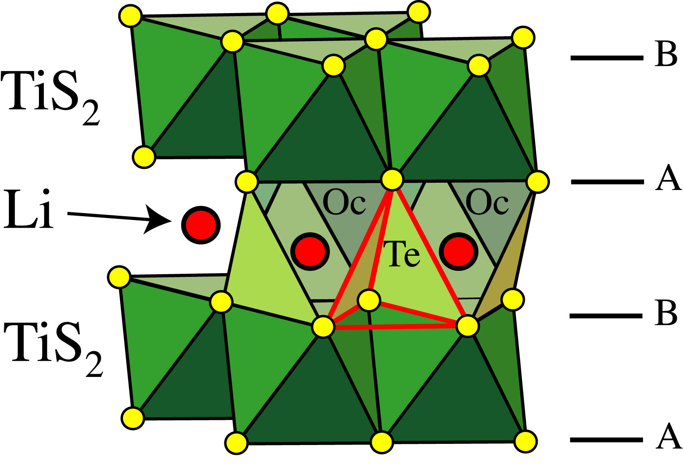
Layered Li_{x}TiS₂

Slide 20
Configurational degrees of freedom
Lithium-vacancy disorder over interstitial sites

Slide 21
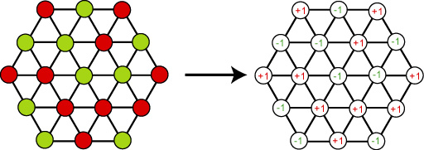
Configurational degrees of freedom
Lithium-vacancy disorder over interstitial sites
Total of 2^{N} configurations

Slide 22
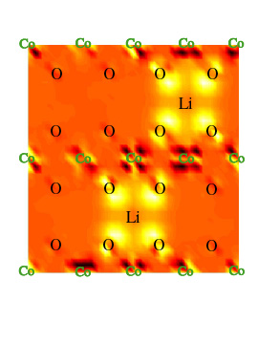
Density Functional Theory
= charge density
Local density (LDA)
Approximation
Generalized Gradient (GGA)
Energy
Lattice parameters
Charge density

Slide 23
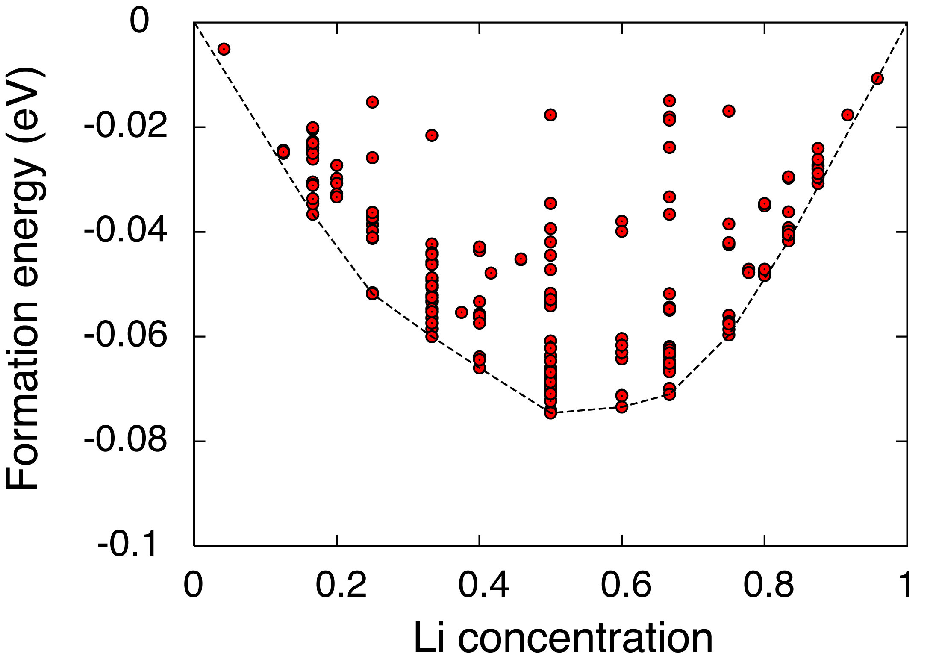
Layered LiTiS₂
Formation energies at zero Kelvin
DFT (LDA), PAW method using VASP

Slide 24
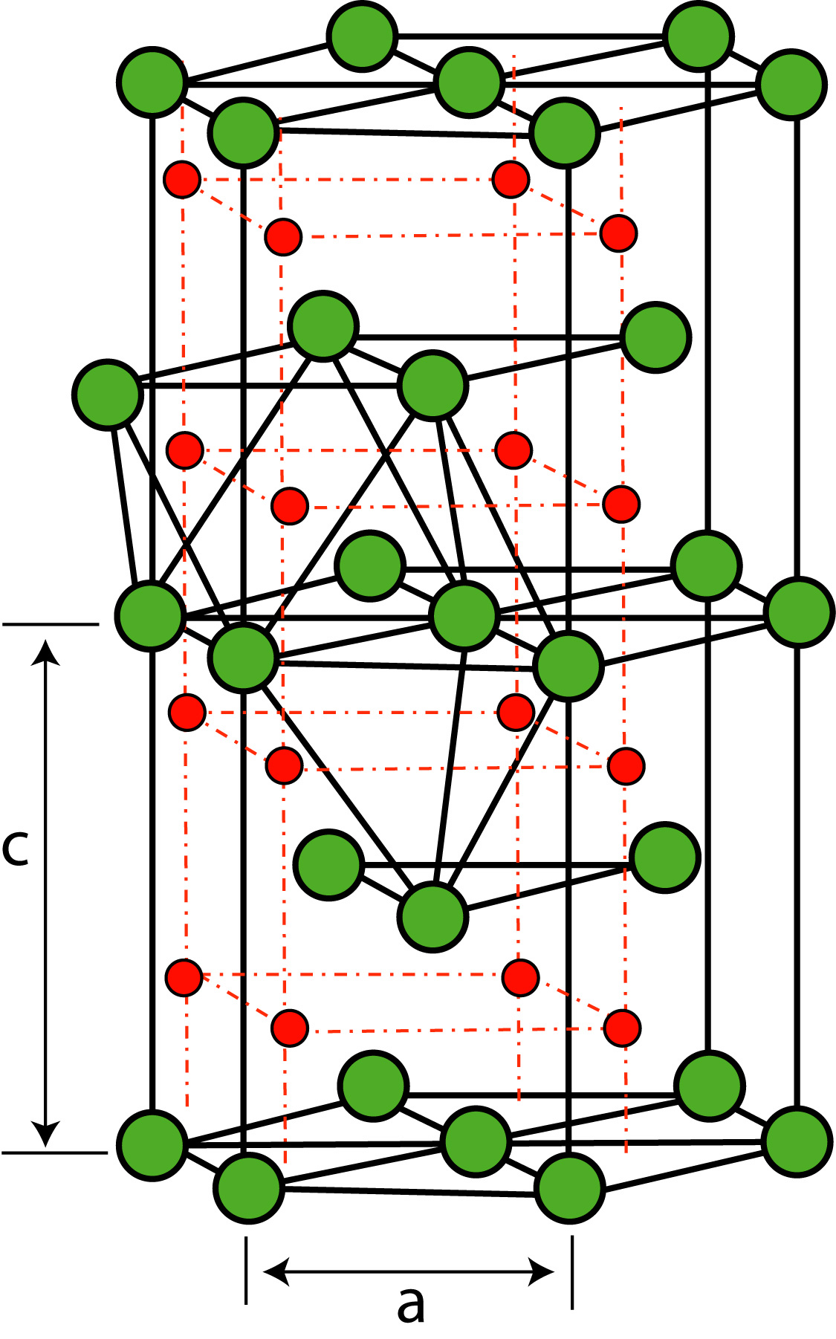
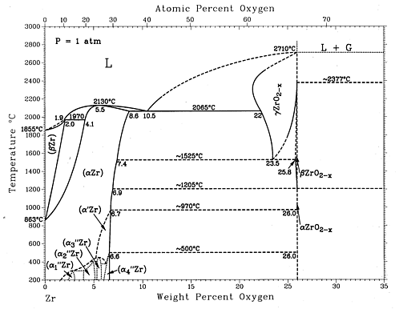
Tutorial Project: Zr-O binary system
Zr:
Very high O solubility
ZrO_{x}
Series of suboxide phases
ZrO_{2-x}
Oxide
J.P. Abriata, J. Garcés, and R. Versaci, Bulletin of Alloy Phase Diagrams Vol. 7 No. 2 1986 .

Slide 25
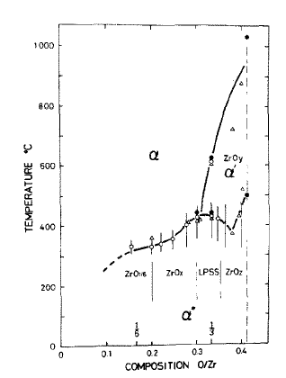
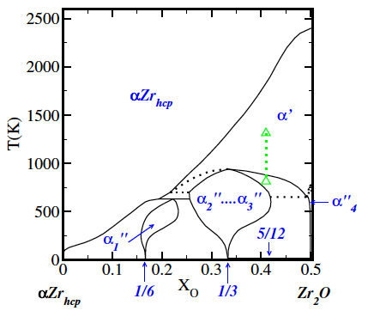
Nature of ZrO_{1/2} disordering transitions?
“the rearrangement of the oxygen atoms from uneven to even distribution on the neighboring interstice planes, and then [to a] random distribution in each plane.” or is low temperature transition first order?
Arai and Hirabayashi, J. Less-Common Metals, 44, 291 (1976).
Burton, Van de Walle, and Stokes, J. Phys. Soc. Japan, 81, 014004 (2012).

Slide 26
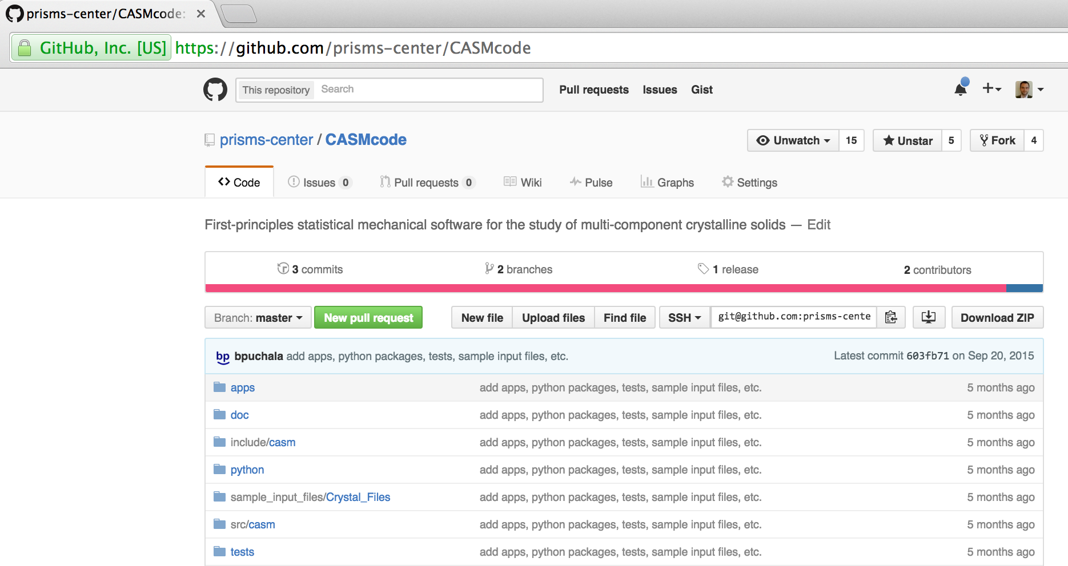
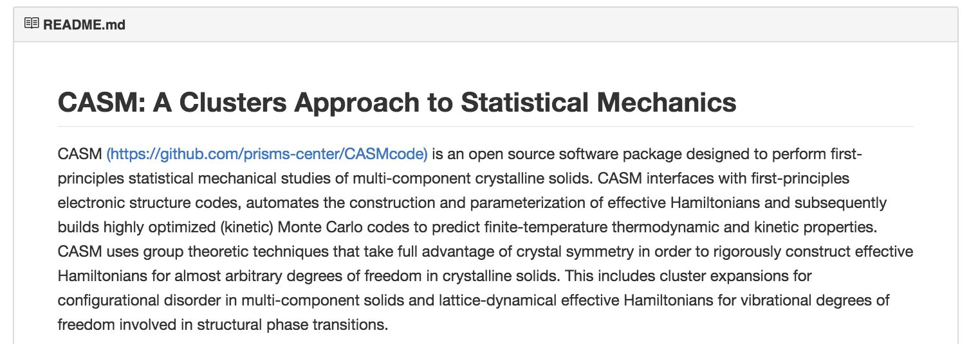
v0.2.0 Now Available!

Slide 27
CASM Design Principles
Reproducibility
Log all commands over the course of a project
Try to record provenance of all data as part of normal workflow
Data Management and Automation
Tools to generate, screen, and dispatch DFT calculations, and then organize, filter, and analyze the results.
Managed directory tree and dependency framework that allows multiple calculation and model parameters to be tested and compared within a single project
Interoperability
Most input and output files are stored in JavaScript Object Notation (JSON)file formats, which is widely used and highly readable.
Weak coupling between CASM and DFT codes, so that CASM can be adapted to work with various existing and future codes.

Slide 28
CASM Design Principles
Collaboration
Easy archival of projects (‘casm files’ command), with granular control over amount and type of data to include.
Parameterized physics models can be shared without data and used to perform finite-temperature simulation
Efficiency
CASM implements unique and highly optimized algorithms for generating and analyzing data and building physics models.
Models are automatically converted to optimized C++ code and then compiled for use in Monte Carlo, enabling larger simulations and improved convergence.

Slide 29
CASM: Overview
Specify the problem: a crystal in which one or more sites has multiple possible occupants:
Oct (O) in HCP-based ZrO_{x}
Ni—Al substitution in FCC Ni_{x}Al_{1-x}
Enumerate many possible symmetrically distinct configurations of the crystal and for each one (i)
Calculate energy E^{(i)}
Calculate symmetry-invariant correlation vector (the configuration’s “fingerprint”)
Fit the linear functional that is the best approximation of E^{(i)}
Use to run Monte Carlo simulations and calculate finite-temperature properties

Slide 30
Problem Definition

Slide 31
Problem Definition

Slide 32
Problem Definition
b
Lattice Vectors
a
y
x

Slide 33
Problem Definition
b
Lattice Vectors
Basis Atoms
a
y
x

Slide 34
Problem Definition
prim.json:
{
"title" : "ZrO”,
"coordinate_mode" : "Fractional",
"description" : “HCP Zr with oct (O) ",
"lattice_vectors" : [
[ 3.233986860000, 0.000000000000, 0.000000000000 ],
[ -1.616993430000, 2.800714770000, 0.000000000000 ],
[ -0.000000000000, 0.000000000000, 5.168678340000 ]
],
"basis" : [
{
"coordinate" : [ 0.0000000, 0.0000000, 0.000000 ],
"occupant_dof" : [ "Zr" ]
},
{
"coordinate" : [ 0.6666667, 0.3333334, 0.500000 ],
"occupant_dof" : [ "Zr" ]
},
{
"coordinate" : [ 0.3333333, 0.6666667, 0.250000 ],
"occupant_dof" : [ "Va", "O" ]
},
{
"coordinate" : [ 0.3333333, 0.6666667, 0.750000 ],
"occupant_dof" : [ "Va", "O" ]
}
]
}
b
Lattice Vectors
Basis Atoms
a
y
x

Slide 35
Problem Definition
prim.json:
{
"title" : "ZrO”,
"coordinate_mode" : "Fractional",
"description" : “HCP Zr with oct (O) ",
"lattice_vectors" : [
[ 3.233986860000, 0.000000000000, 0.000000000000 ],
[ -1.616993430000, 2.800714770000, 0.000000000000 ],
[ -0.000000000000, 0.000000000000, 5.168678340000 ]
],
"basis" : [
{
"coordinate" : [ 0.0000000, 0.0000000, 0.000000 ],
"occupant_dof" : [ "Zr" ]
},
{
"coordinate" : [ 0.6666667, 0.3333334, 0.500000 ],
"occupant_dof" : [ "Zr" ]
},
{
"coordinate" : [ 0.3333333, 0.6666667, 0.250000 ],
"occupant_dof" : [ "Va", "O" ]
},
{
"coordinate" : [ 0.3333333, 0.6666667, 0.750000 ],
"occupant_dof" : [ "Va", "O" ]
}
]
}
a
b
b
c
x
y
z
Basis Atoms
Lattice Vectors
a
y
x

Slide 36
Problem Definition
prim.json:
{
"title" : "ZrO”,
"coordinate_mode" : "Fractional",
"description" : “HCP Zr with oct (O) ",
"lattice_vectors" : [
[ 3.233986860000, 0.000000000000, 0.000000000000 ],
[ -1.616993430000, 2.800714770000, 0.000000000000 ],
[ -0.000000000000, 0.000000000000, 5.168678340000 ]
],
"basis" : [
{
"coordinate" : [ 0.0000000, 0.0000000, 0.000000 ],
"occupant_dof" : [ "Zr" ]
},
{
"coordinate" : [ 0.6666667, 0.3333334, 0.500000 ],
"occupant_dof" : [ "Zr" ]
},
{
"coordinate" : [ 0.3333333, 0.6666667, 0.250000 ],
"occupant_dof" : [ "Va", "O" ]
},
{
"coordinate" : [ 0.3333333, 0.6666667, 0.750000 ],
"occupant_dof" : [ "Va", "O" ]
}
]
}
a
b
b
c
x
y
z
Basis Atoms
Lattice Vectors
a
y
x

Slide 37
Problem Definition
prim.json:
{
"title" : "ZrO”,
"coordinate_mode" : "Fractional",
"description" : “HCP Zr with oct (O) ",
"lattice_vectors" : [
[ 3.233986860000, 0.000000000000, 0.000000000000 ],
[ -1.616993430000, 2.800714770000, 0.000000000000 ],
[ -0.000000000000, 0.000000000000, 5.168678340000 ]
],
"basis" : [
{
"coordinate" : [ 0.0000000, 0.0000000, 0.000000 ],
"occupant_dof" : [ "Zr" ]
},
{
"coordinate" : [ 0.6666667, 0.3333334, 0.500000 ],
"occupant_dof" : [ "Zr" ]
},
{
"coordinate" : [ 0.3333333, 0.6666667, 0.250000 ],
"occupant_dof" : [ "Va", "O" ]
},
{
"coordinate" : [ 0.3333333, 0.6666667, 0.750000 ],
"occupant_dof" : [ "Va", "O" ]
}
]
}
a
b
b
c
x
y
z
Basis Atoms
Lattice Vectors
a
y
x
JSON: JavaScript Object Notation

Slide 38
Problem Definition
PRIM (legacy format):
// HCP Zr-O
1.00000000
1.61699343 2.80071477 0.00000000
-1.61699343 2.80071477 0.00000000
0.00000000 0.00000000 5.16867834
2 2
Direct
0.0000000 0.0000000 0.0000000 Zr
0.6666667 0.6666667 0.5000000 Zr
0.3333333 0.3333333 0.2500000 Va O
0.3333333 0.3333333 0.7500000 Va O
a
b
c
b
Lattice Vectors
Basis Atoms
a
Similar format to VASP POSCAR
y
x

Slide 39
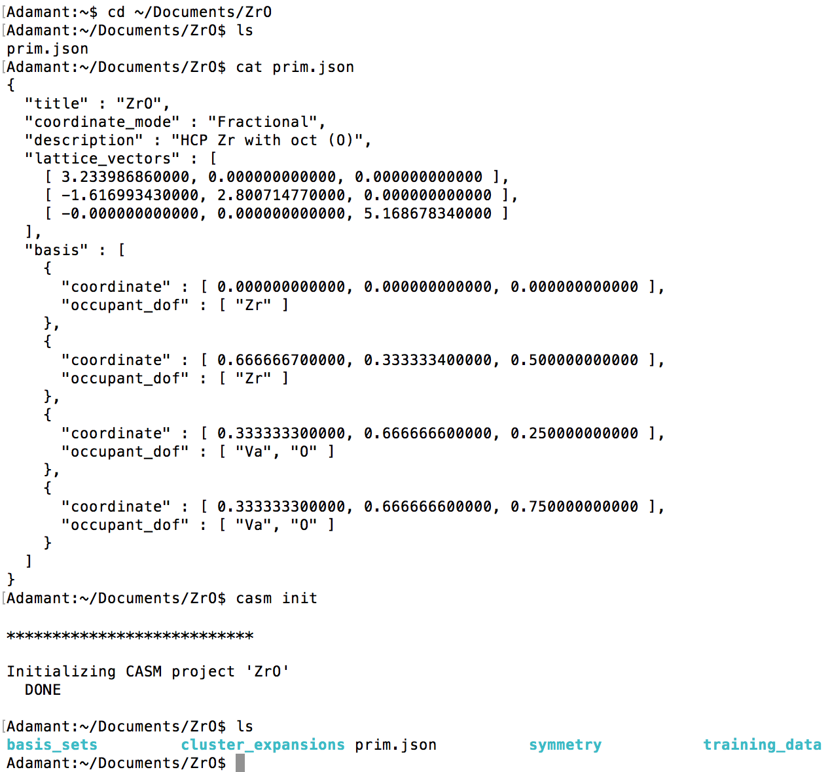
CASM: Getting started
Material
definition
Initialization
Generated
directories

Slide 40
CASM: Getting started
Install 'casm' command line programs
'casm status'
Quick look at your current project
Suggestions for next steps
'casm format'
Documentation of project directory and file formats
'casm –h'
Help menus show allowed options

Slide 41
Crystal Symmetry
Apply rotation, reflection, inversion, and/or rotation to the crystal.

Slide 42
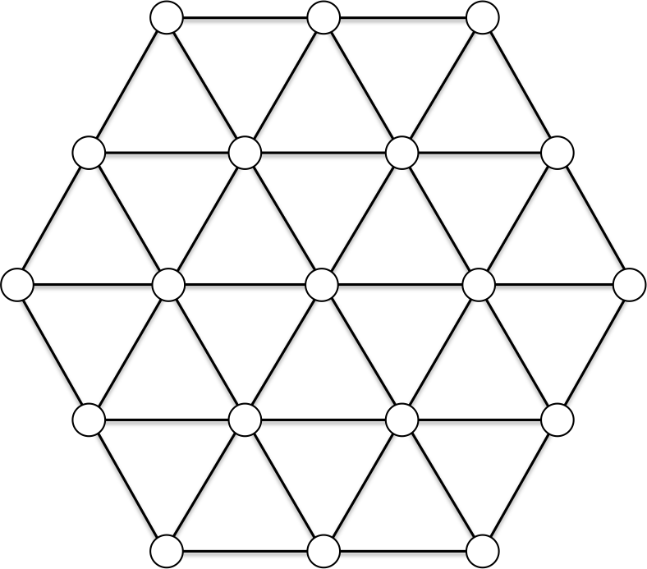
Crystal Symmetry
Apply rotation, reflection, inversion, and/or rotation to the crystal.
60°

Slide 43
Crystal Symmetry
Apply rotation, reflection, inversion, and/or rotation to the crystal.
If the result is indistinguishable from the initial state, then that operation is in the crystal’s space group.
60°

Slide 44
Crystal Symmetry
Common notation: {R_{α}|τ}
R_{α}: point group operations such as rotations, reflections, improper rotations, inversions
τ: translation vector
α: 3x3 transformation matrix
M.S. Dresselhaus, G. Dresselhaus, and A. Jorio.
Group Theory: Application to the Physics of Condensed Matter.

Slide 45
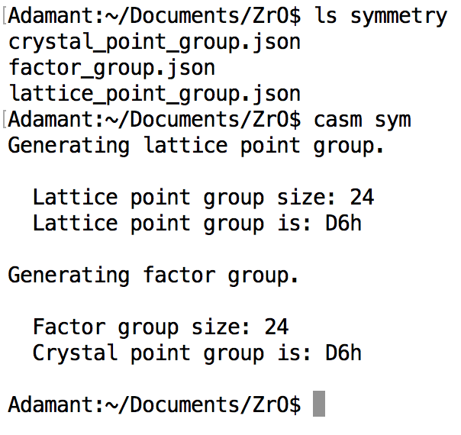
Symmetry
Lattice point group:
Symmetry operations that map lattice onto itself, leaving origin invariant (rotation, mirror, inversion, rotoinversion)
Crystal factor group:
Symmetry operations that map lattice and identical basis sites onto themselves (translations may result in screw axes or glide planes)
Crystal point group:
Crystal factor group operations, with translations removed

Slide 46
Crystal Configurations

Slide 47
Crystal Configurations

Slide 48
Crystal Configurations
Vol 2 Supercell
Vol 4 Supercell

Slide 49
Crystal Configurations

Slide 50
Crystal Configurations
Equivalent!!
60°

Slide 51
Supercell Enumeration
S₁=P₁ S₂=2P₂
Represent lattice using column vector matrices:
P: primitive lattice
S: supercell lattice
T: integer supercell transformation matrix
S₂
S₁
P₂
S₂
S₁
S₁=P₁+P₂ S₂=-P₁+P₂
P₁

Slide 52
Supercell Enumeration
Equivalent supercells:
Linear combination of supercell lattice vectors
S
S'

Slide 53
Supercell Enumeration
Equivalent supercells:
Linear combination of symmetrically equivalent supercell lattice vectors
For a crystal, allowed symmetry operations depends on crystal basis
S
S'

Slide 54
Supercell enumeration
If unit cell lattice, P, is represented as column vector matrix, then supercell lattices, S, are:
T is an integer supercell transformation matrix, and S has integer volume det(T), relative to the primitive cell.
Supercells are equivalent if for some T:
At a given volume (det(T)), loop over possible T matrices and use crystal point group operations to check if we've found a new symmetrically distinct supercell

Slide 55
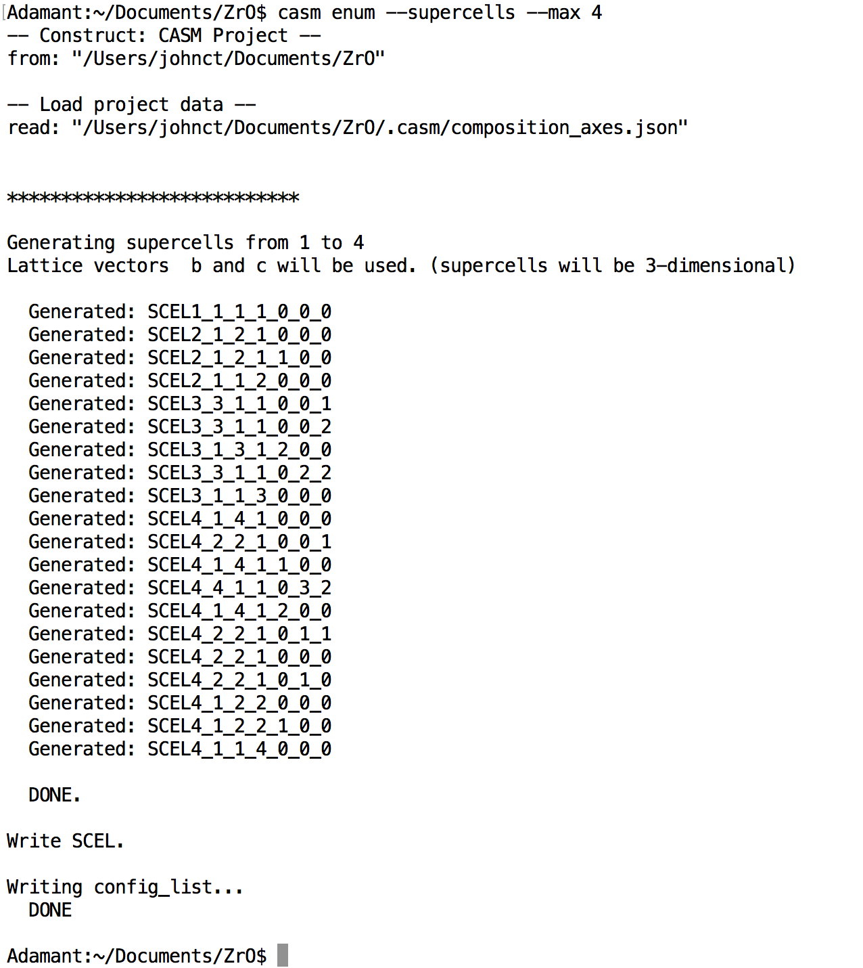
Supercell enumeration
Max an min supercell volume can be specified for enumeration
SCEL4_1_4_1_0_0_0
Supercell enumeration can be restricted to 1D and 2D. See casm enum --help
for details.
Volume
Shape Factors

Slide 56
Configuration enumeration
A:
Equivalent configurations:
Supercells of the volume 1 configuration
B:

Slide 57
Configuration enumeration
A:
Equivalent configurations:
Translation maps one configuration onto the other
B:

Slide 58
Configuration enumeration
A:
Equivalent configurations:
Rotation or translation maps occupants
B:

Slide 59
Configuration enumeration
Enumerate symmetrically unique configurations by:
Loop over possible occupations
Check all factor group operations that keep the supercell lattice vectors unchanged, in combination with all primitive cell translations within the supercell
If translation within the supercell alone maps all occupants, then it is a supercell of a smaller primitive configuration

Slide 60
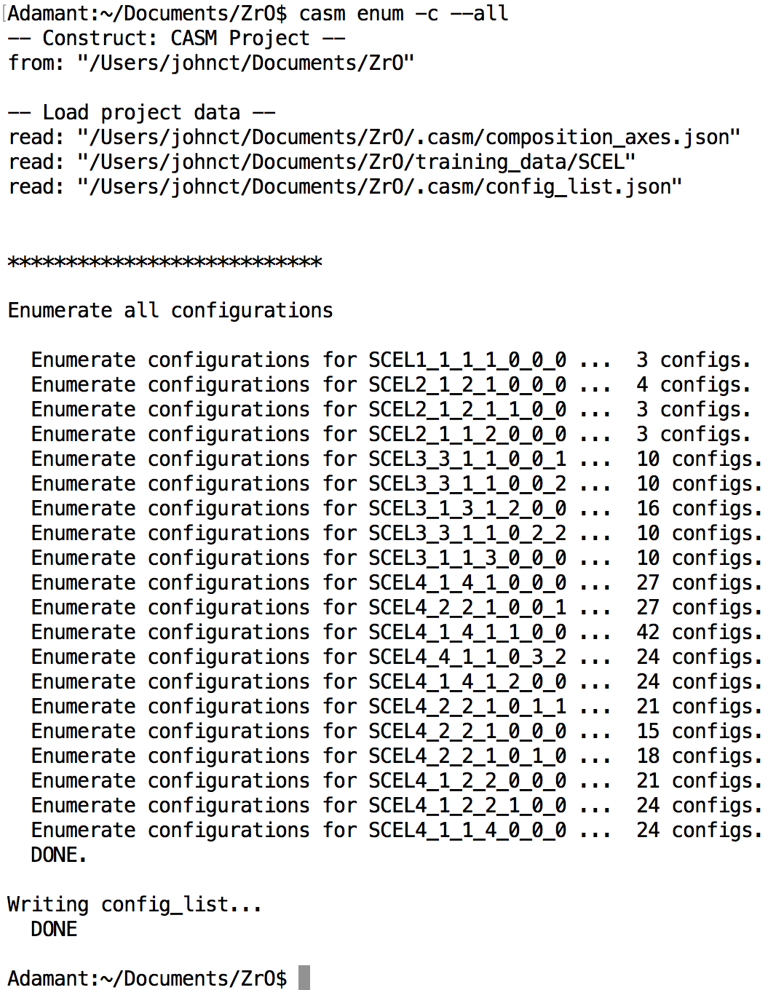
Configuration enumeration
Configurations are enumerated ONLY in supercells that have been enumerated.
You can specify the min and max supercell volumes, or specify a supercell explicitly.
CAUTION: The number of unique configurations that fit in a supercell grows exponentially with supercell volume.

Slide 61
Configuration visualization
Set up environment:
casm settings --set-view-command 'casm.view VESTA’
Try with one or more configuration names:
casm view SCEL4_2_2_1_0_0_1/25

Slide 62
CASM Composition metrics
Each configuration has a composition, and there are various ways to measure it:
atom_frac: atom_frac(Au), atom_frac(Cu), etc.
Number of Au, Cu, etc., divided by total number of atoms. Vacancies are ignored.
comp_n: comp_n(Au), comp_n(Cu), etc.
Number of Au, Cu, etc., divided by number of primitive cells (volume). Accounts for vacancies.
comp: comp(a), comp(b), etc.
Primitive-cell-based formula parameters (e.g., Au_{a}Cu_{b}Pt_{(1-a-b)}), determined by user-specified composition axes. Accounts for vacancies.
When vacancies are present, ‘atom_frac’ is qualitatively different from ‘comp_n’ and ‘comp’

Slide 63
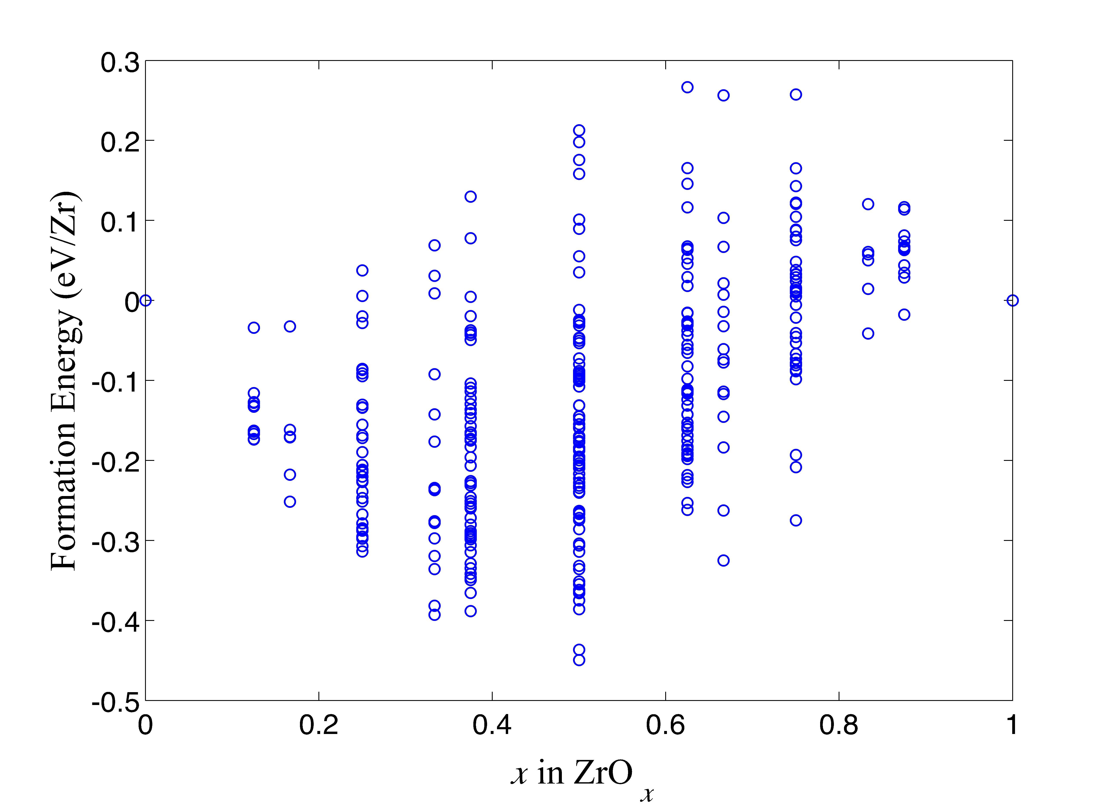
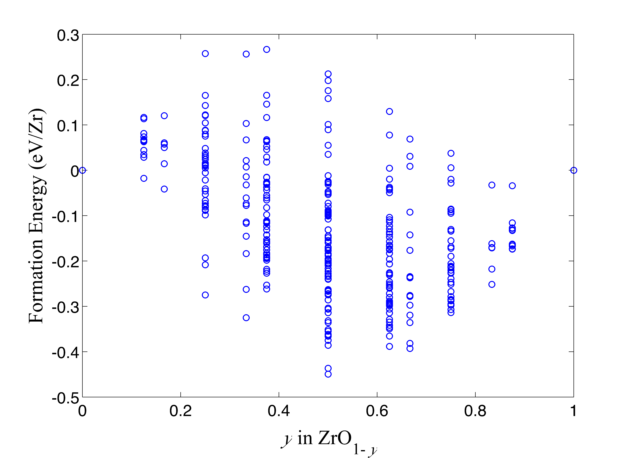
Specifying composition axes
Binary Compound:

Slide 64
Specifying composition axes
Binary Compound:
Ternary Compound:
Au
b
a
Cu_{1-a-b}Au_{b}Pt_{a}
Cu_{b}Au_{a}Pt_{1-a-b}
Cu
a
b
Pt

Slide 65
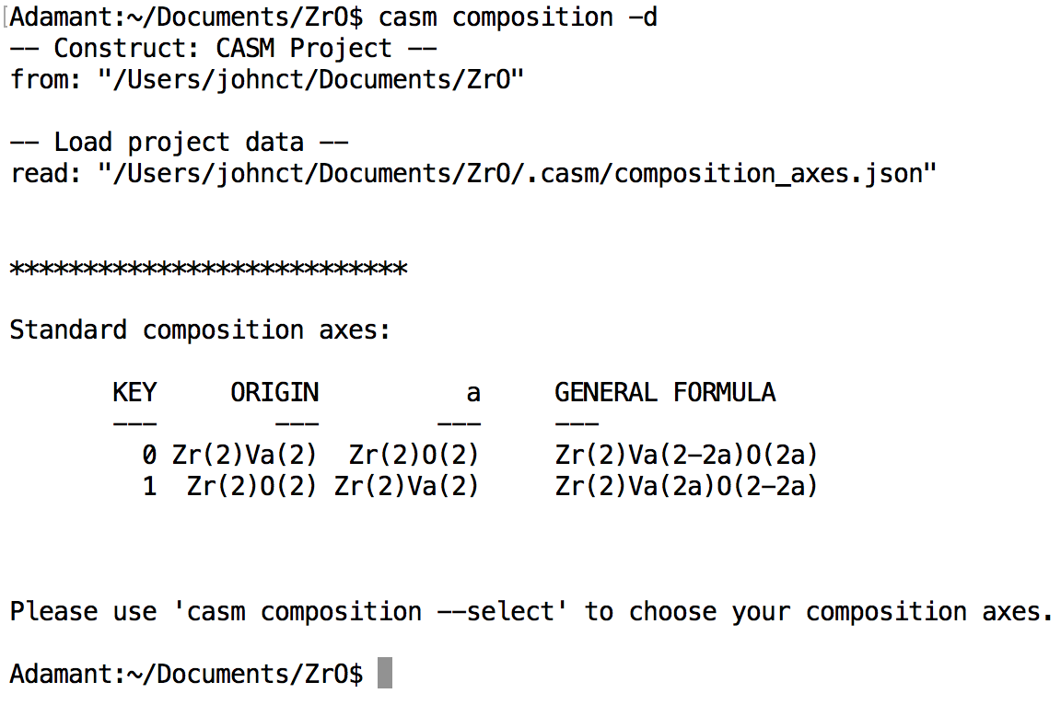
Specifying composition axes
Zr₂O_{2a}[Va]_{2(1-a)}
Zr₂O_{2(1-a)}[Va]_{2a}
NOTE: prim.json determines formula unit (2 Zr)

Slide 66
Data Management
Project data is managed according to the parameters, settings, and timeline that it depends on:
‘calctype’ DFT parameters and setting (XC functional, pseudopotential, convergence parameters, etc.)
‘property’ The particular quantity being measured (formation_energy, volume_relaxation, etc.)
‘ref’ Baseline reference used for measuring quantity (zero-point of energy, reference volume, etc.)
‘bset’ Basis functions used to “fingerprint” configurations and in terms of which the property model is expressed .
‘eci’ The model parameters (effective cluster interactions) used to predict a particular property in terms of a particular basis set.
Manage and create settings profiles from the ‘casm settings’ command. A ‘default’ profile is created during project initialized.
Ex:
DFT-calculated properties: Depend on ‘calctype’, ‘property’, and sometimes ‘ref’
Cluster expansion/physics model: Depends on ‘calctype’, ‘property’, ‘ref’, ‘bset’
Predicted properties and Monte Carlo Data: Depend on ‘calctype’, ‘property’, ‘ref’, ‘bset’, and ‘eci’

Slide 67
Data Management Workflow
Configuration Database
Records configurations that have been enumerated or imported to a project and their associated data
Configuration Selection
Configuration Selection
References to subset of the configuration database.
CASM
Job Dispatch
Info/Analysis

Slide 68
Working with selections
CASM query syntax provides simple interface to explore, screen, and select configurations.
Example:
casm select --set "eq(scel_size, 4)"
will select all configurations the belong to supercells of volume 4 (relative to primitive cell)
Many configuration properties are supported
‘scel_size’ Integer volume of supercell that contains the configuration
‘comp(a)’, ‘comp(b)’, etc. The chemical composition, in terms of composition axes
‘atom_frac(Au)’, etc. The atomic fraction of a particular specie
‘is_calculated’ True if DFT data exists for the configuration
‘formation_energy’ DFT formation energy (if calculated)
‘volume relaxation Change in volume due to relaxation (expressed as V/V₀)
… and many others (for full listing see casm select --help properties)
Properties can be related and compared via operators
arithmetic add, subtract, multiply, divide, sqrt, exp
comparison equality, less-than, greater-than, etc.
logical AND, OR, NOT, etc.
ranges min, max, and others
text search and match with regular expressions
for documentation see casm select --help operators

Slide 69
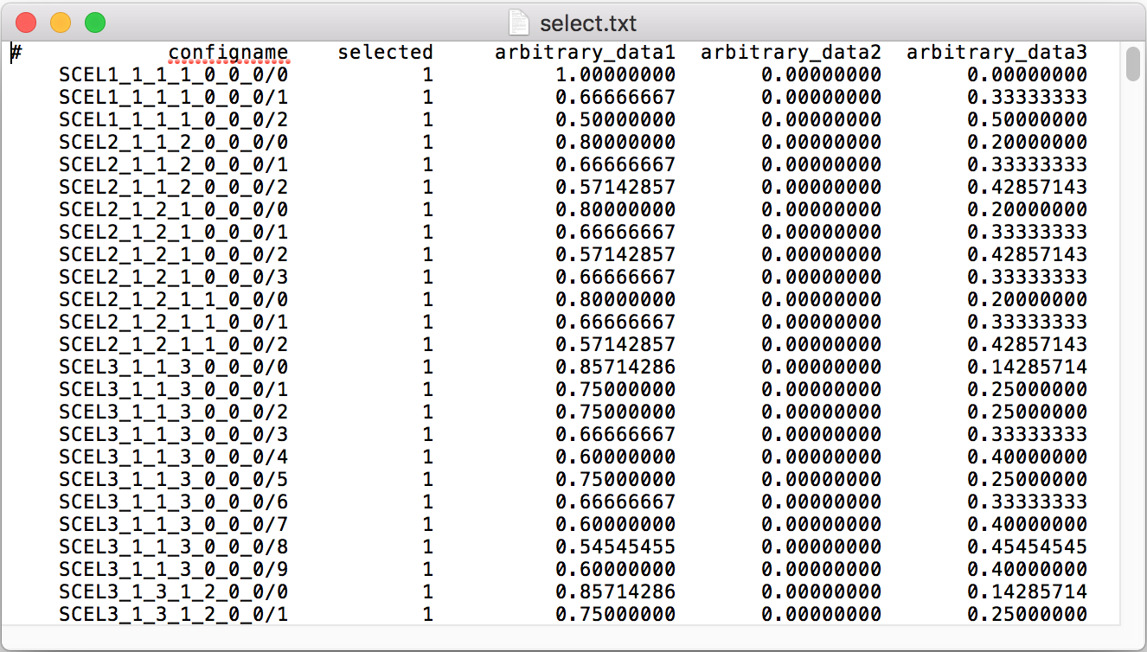
Working with selections
Selections can be edited and combined using ‘casm select’
The ‘MASTER’ selection is stored in the configuration database and is the default selection for most operations. A selection can be redirected to a file using --output <filename>
Selection(s) to be operated can be read from a file using --configs <filename>
Edit selections using CASM query syntax
casm select --set <query> Create a selection from scratch
casm select --set-on <query> Set ‘selected’ from false to true if <query> is true
casm select --set-off <query> Set ‘selected’ from true to false if <query> is true
Combine selections using logical operators (AND, OR, NOT, XOR)

Slide 70
Working with selections
Selections can be edited and combined using ‘casm select’
The ‘MASTER’ selection is stored in the configuration database and is the default selection for most operations. A selection can be redirected to a file using --output <filename>
Selection(s) to be operated can be read from a file using --configs <filename>
Edit selections using CASM query syntax
casm select --set <query> Create a selection from scratch
casm select --set-on <query> Set ‘selected’ from false to true if <query> is true
casm select --set-off <query> Set ‘selected’ from true to false if <query> is true
Combine selections using logical operators (AND, OR, NOT, XOR)
Predefined selections:
‘ALL’: specifies the total configuration database.
‘CALCULATED’: specifies all configurations for which DFT data exist.
‘NONE’: equivalent to ‘ALL’ but with all ‘selected’ bits set to 0

Slide 71
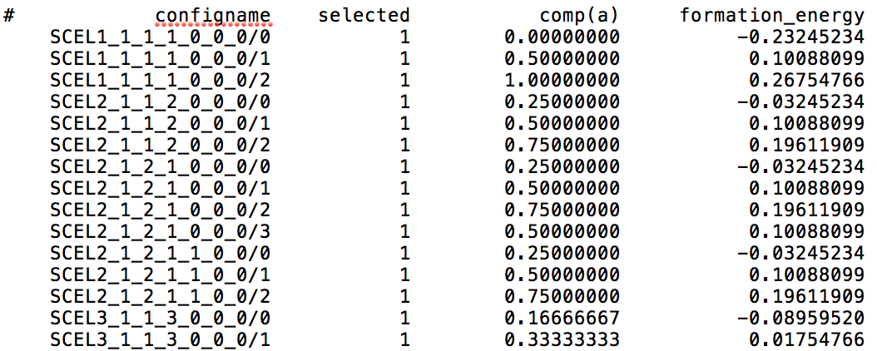
CASM Query Syntax, Part II
CASM query syntax provides simple interface to explore, screen, and select configurations.
Use ‘casm query’ to print properties of selected configurations (supports JSON and CSV)
Example:
casm query --columns "comp(a)" "formation_energy" --configs select.csv
will print ‘casm select’-style CSV output to the screen:
output can be redirected to a file with --output <filename>
Query syntax can also be used to screen configurations at the enumeration stage, so they don’t pollute the configuration database.
Example:
casm enum --configurations --all --filter "lt(atom_frac(O),0.25)"
will only enumerate configurations that are dilute in oxygen (having O atomic fraction less than 0.25)

Slide 72
DFT calculations
Provide DFT code input files and parameters
Pseudopotentials, k-point density, energy cut-off, and settings files
Use ‘casm select’ to identify a selection of configurations to calculate
casm run –e vasp.relax --configs my_selection.csv
vasp.relax is python script that automates job submission for each configuration. It submits the DFT calculation, handles common errors, ensures that results are converged and relaxed, and writes results to a format CASM understands (properties.calc.json).
Uses ‘pbs’ python module to automate job submission (https://github.com/prisms-center/pbs)
Current support for VASP, support for other codes is planned. Contributions from the user community are encouraged!

Slide 73
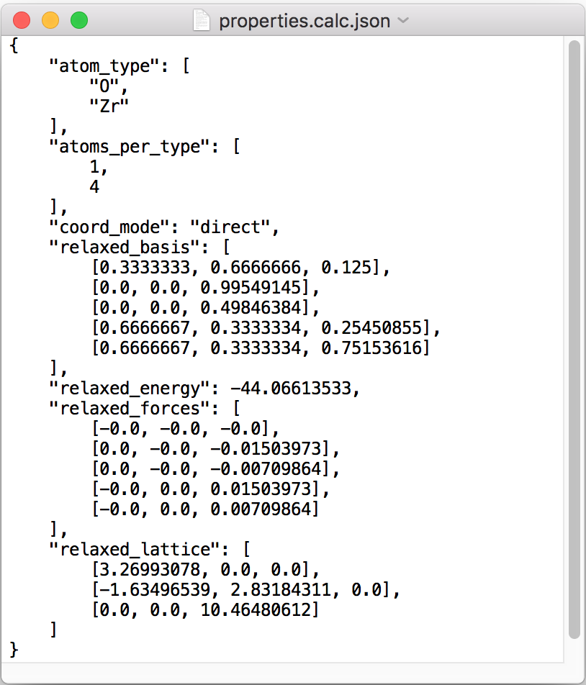
properties.calc.json files
$ROOT/training_data/$SCEL/$CONFIGID/calctype.$CALCTYPE/
CASM interprets calculation data from properties.calc.json file
Generated by ‘vasp.relax’ or manually using ‘vasp.relax.report’

Slide 74

Relaxations and Mapping/Import
casm update:
Read all new property files, and check relaxation
lattice_deformation (LD):
Degree of homogeneous strain (per atom)
basis_deformation (BD):
Mean square displacement
total deformation cost:
w*LD+(1-w)*BD , 0<w<1
casm import:
Use same algorithms as casm update to add ideal or relaxed configurations to project (even if not enumerated)
Very large relaxations may change the configuration. Conflicts can be resolved using either min-energy or min-deformation rule

Slide 75
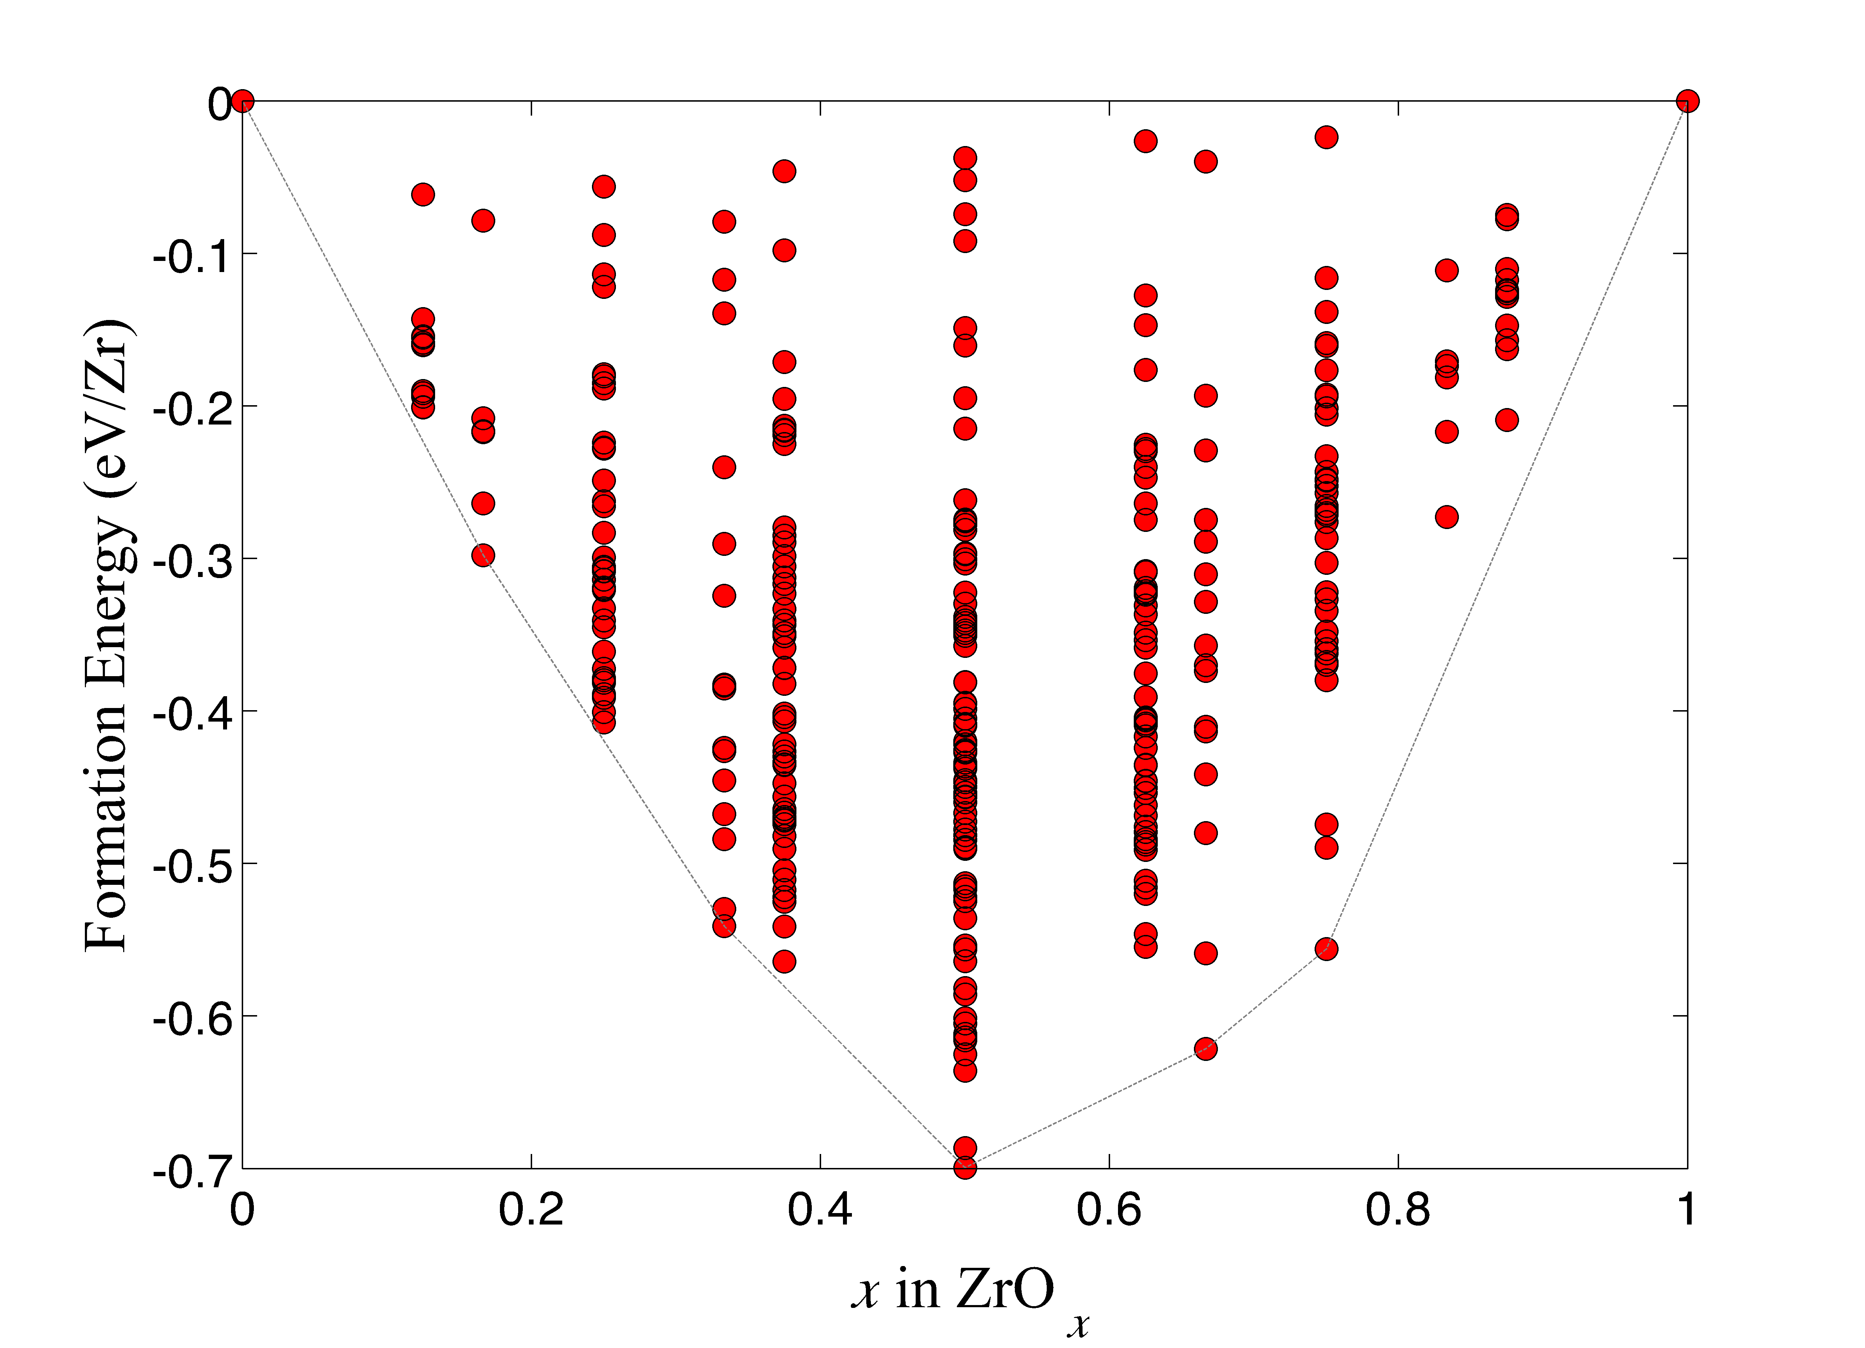
Setting energy reference
Chemical energy can only be measured relative to reference compounds

Slide 76
Setting energy reference
Chemical energy can only be measured relative to reference compounds

Slide 77
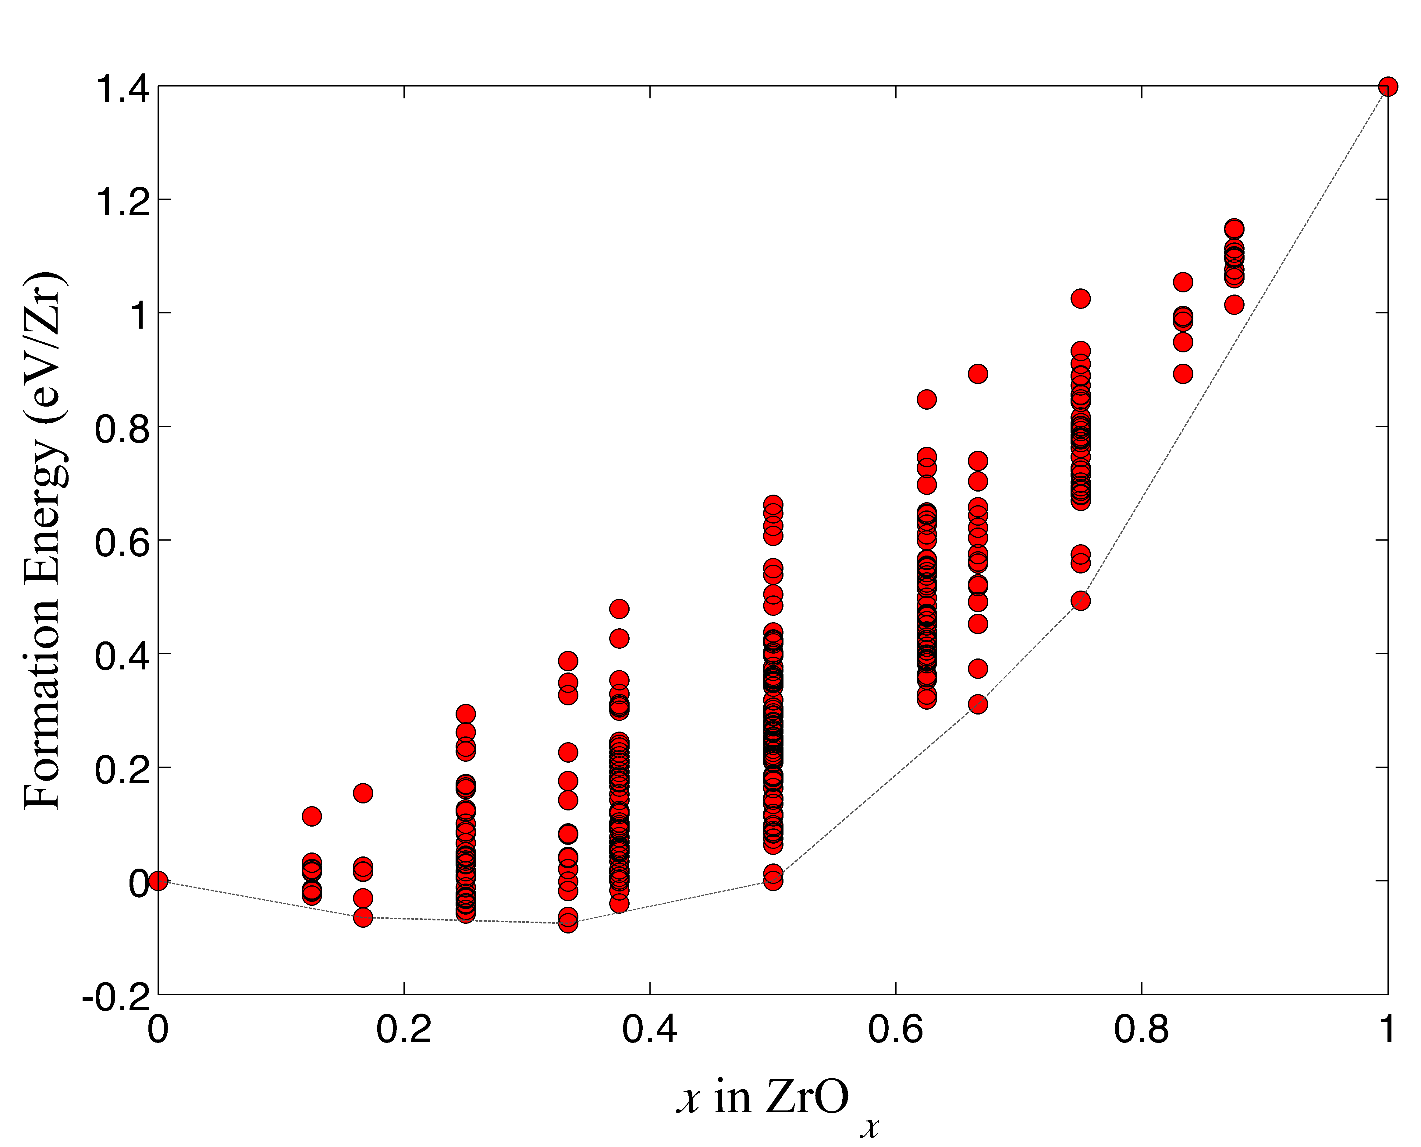
Setting energy reference
Chemical energy can only be measured relative to reference compounds
casm ref --set-auto will attempt to set energy references as near to extreme stoichiometries as possible (left case)

Slide 78
CASM: Clusters Approach to Statistical Mechanics
First-principles energies of a “few” excitations
Extrapolate to
all other excitations
Lattice Model Hamiltonian
Monte Carlo
Thermodynamics

Slide 79
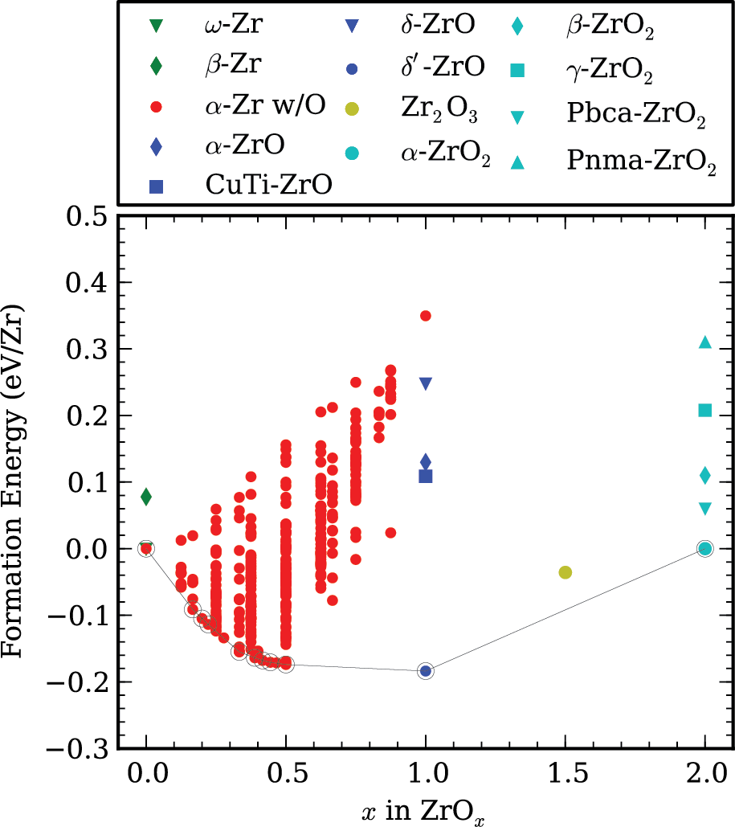
Zr-O system
Each red circle specifies belongs to a specific configuration of HCP-based ZrO_{x}
Puchala and Van der Ven, Phys. Rev. B 88 094108 (2013).

Slide 80
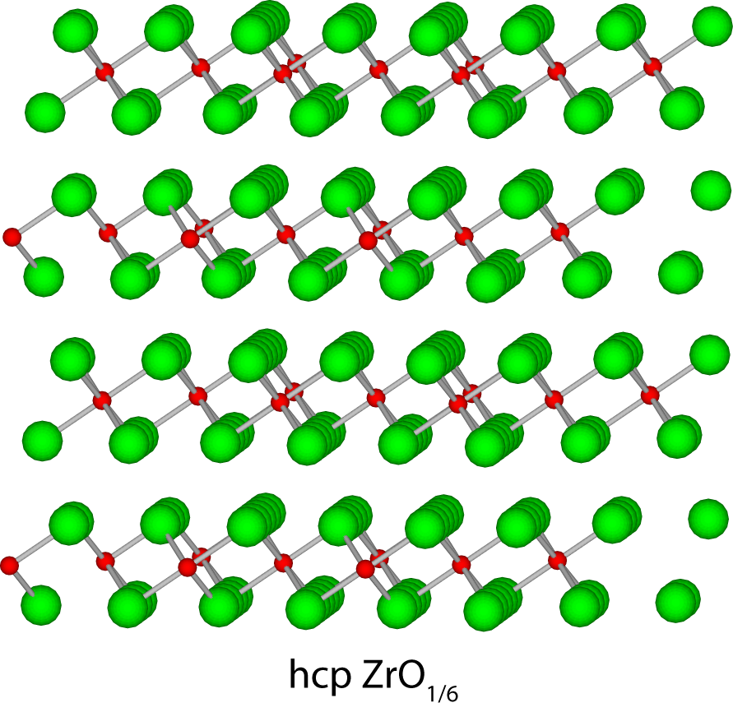
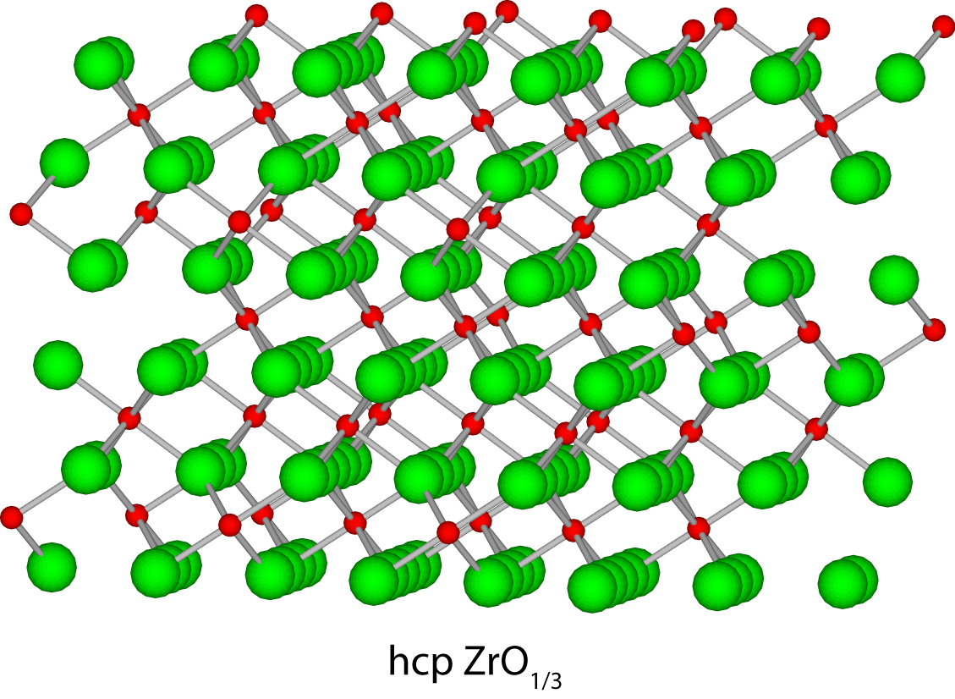
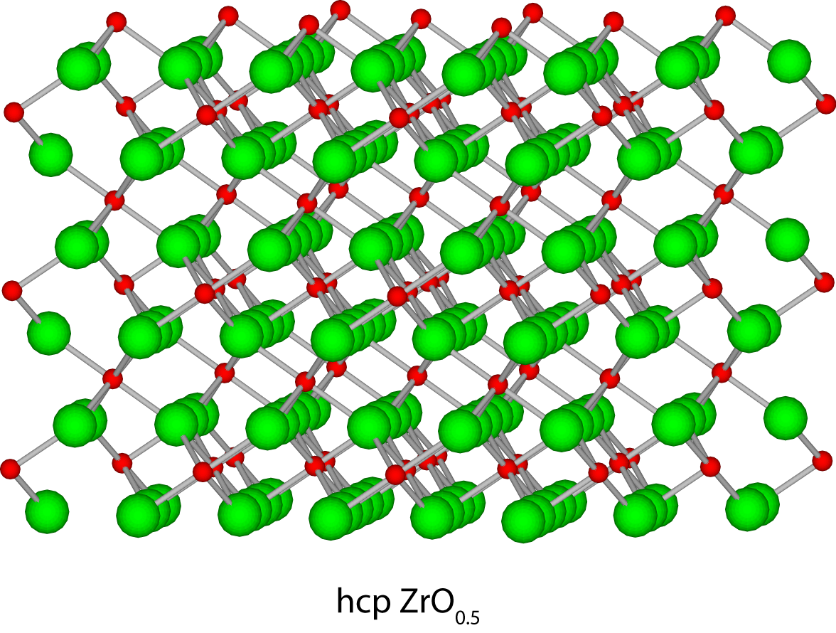
Zr-O system
A
A
A
-
B
BC
B
C
A
-
A
BC
C
-
B
A
A
C
BC
ZrO_{1/6}
ZrO_{1/3}
ZrO_{1/2}
Puchala and Van der Ven, Phys. Rev. B 88 094108 (2013).

Slide 81
Zr-O system
ZrO_{1/6} if X = 0
ZrO_{1/2} if X = 2/3
ZrO_{1/6}-ZrO_{1/3}
ZrO_{1/3}-ZrO_{1/2}
O stacking sequences
Puchala and Van der Ven, Phys. Rev. B 88 094108 (2013).
de Fontaine, Nature 343, 544 (1990).

Slide 82
CASM: Clusters Approach to Statistical Mechanics
First-principles energies of a “few” excitations
Extrapolate to
all other excitations
Lattice Model Hamiltonian
Monte Carlo
Thermodynamics

Slide 83
The Clusters Approach to Statistical Mechanics
Is there a compact way to approximate the energy of any configuration?
y
x

Slide 84
The Clusters Approach to Statistical Mechanics
Is there a compact way to approximate the energy of any configuration?
y
x
Species A
Species B

Slide 85
The Clusters Approach to Statistical Mechanics
Is there a compact way to approximate the energy of any configuration?
y
x
Species A
Species B

Slide 86
The Clusters Approach to Statistical Mechanics
Is there a compact way to approximate the energy of any configuration?
y
x
Species A
Species B

Slide 87
The Clusters Approach to Statistical Mechanics
Is there a compact way to approximate the energy of any configuration?
y
x
Species A
Species B

Slide 88
The Clusters Approach to Statistical Mechanics
Is there a compact way to approximate the energy of any configuration?
y
x
Species A
Species B

Slide 89
The Clusters Approach to Statistical Mechanics
Is there a compact way to approximate the energy of any configuration?
y
x
Species A
Species B

Slide 90
The Clusters Approach to Statistical Mechanics
The orbit of the the NN pair
Is there a compact way to approximate the energy of any configuration?
Symmetric averages of measurements of cluster occupation states.
y
x
Species A
Species B

Slide 91
The Clusters Approach to Statistical Mechanics
Is there a compact way to approximate the energy of any configuration?
Symmetric averages of measurements of cluster occupation states.
y
x
Species A
Species B

Slide 92
The Clusters Approach to Statistical Mechanics
Is there a compact way to approximate the energy of any configuration?
Symmetric averages of measurements of cluster occupation states.
y
x
Species A
Species B

Slide 93
The Cluster Expansion
y
x
Species A
Species B

Slide 94
The Cluster Expansion
σ₁₅
σ₁₆
σ₁₇
The occupant of lattice site i is described by the variable σ_{i} :
σ_{i} = +1 if species A
σ_{i} = -1 if species B
σ₁₄
σ₅
σ₆
σ₁₈
σ₁₃
σ₄
σ₁
σ₇
σ₁₉
σ₁₂
σ₃
σ₂
σ₈
σ₁₁
σ₁₀
σ₉
Species A
Species B

Slide 95
The Cluster Expansion
σ₁₅
σ₁₆
σ₁₇
Interactions between sites are described by products of σ_{i} .
Fit interaction parameters to a database of DFT energies.
σ₁₄
σ₅
σ₆
σ₁₈
σ₁₃
σ₄
σ₁
σ₇
σ₁₉
σ₁₂
σ₃
σ₂
σ₈
σ₁₁
σ₁₀
σ₉
E = J₁σ₁ + J_{1,7}σ₁σ₇ + J_{1,18}σ₁σ₁₈ + J_{1,17}σ₁σ₁₇ + J_{1,4,5}σ₁σ₄σ₅ + . . .
Then use symmetry to average over the entire crystal

Slide 96
Cluster Expansion Example
σ₁₅
σ₁₆
σ₁₇
σ₁₄
σ₅
σ₆
σ₁₈
σ₁₃
σ₄
σ₁
σ₇
σ₁₉
σ₁₂
σ₃
σ₂
σ₈
σ₁₁
σ₁₀
σ₉

Slide 97
Cluster Expansion Example
σ₁₅
σ₁₆
σ₁₇
σ₁₄
σ₅
σ₆
σ₁₈
σ₁₃
σ₄
σ₁
σ₇
σ₁₉
Average site occupation is Γ₁=(σ₁ + σ₆)/2=0
σ₁₂
σ₃
σ₂
σ₈
σ₁₁
σ₁₀
σ₉

Slide 98
Cluster Expansion Example
σ₁₅
σ₁₆
σ₁₇
σ₁₄
σ₅
σ₆
σ₁₈
σ₁₃
σ₄
σ₁
σ₇
σ₁₉
Average site occupation is Γ₁=(σ₁ + σ₆)/2=0
σ₁₂
σ₃
σ₂
σ₈
σ₁₁
σ₁₀
σ₉

Slide 99
Cluster Expansion Example
σ₁₅
σ₁₆
σ₁₇
σ₁₄
σ₅
σ₆
σ₁₈
σ₁₃
σ₄
σ₁
σ₇
σ₁₉
Average site occupation is Γ₁=(σ₁ + σ₆)/2=0
Average NN pair occupation is Γ₂=(σ₁σ₇ + σ₁σ₆ + σ₁σ₅ + σ₆σ₁₈ + σ₆σ₁₇ + σ₆σ₁₆)/6 = 1/3
σ₁₂
σ₃
σ₂
σ₈
σ₁₁
σ₁₀
σ₉

Slide 100
Cluster Expansion Example
σ₁₅
σ₁₆
σ₁₇
σ₁₄
σ₅
σ₆
σ₁₈
σ₁₅
σ₁₆
σ₁₇
σ₁₃
σ₄
σ₁
σ₇
σ₁₉
σ₁₄
σ₅
σ₆
σ₁₈
σ₃
σ₂
σ₈
σ₁₂
σ₁₃
σ₄
σ₁
σ₇
σ₁₉
σ₁₁
σ₁₀
σ₉
σ₁₂
σ₃
σ₂
σ₈
Correlations are identical for symmetrically equivalent configurations
σ₁₁
σ₁₀
σ₉

Slide 101
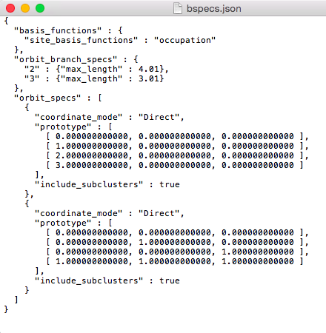
The bspecs.json file
Specifications for generating clusters and the cluster expansion basis functions

Slide 102
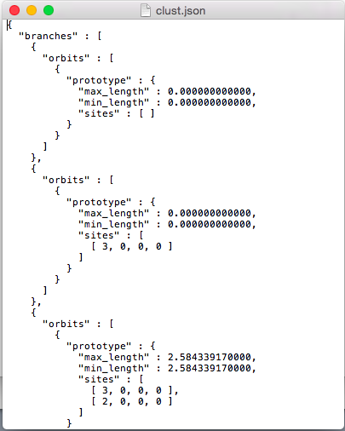
The clust.json file
Lists one example (“prototype”) of each cluster type

Slide 103
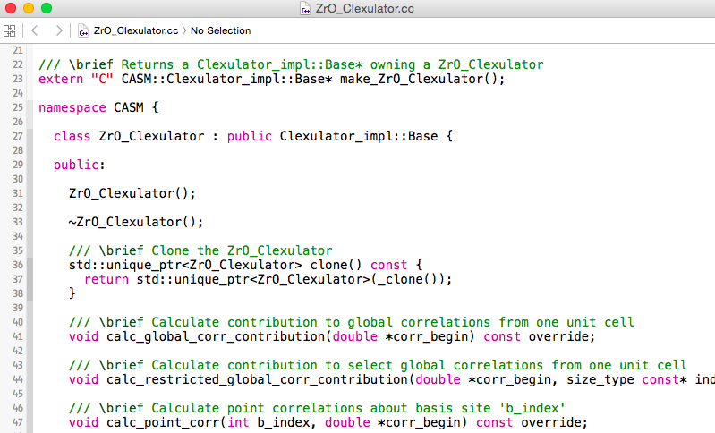
The clexulator (ZrO_Clexulator.cc)
Generated code for evaluating basis functions
Generated code for evaluating basis functions

Slide 104
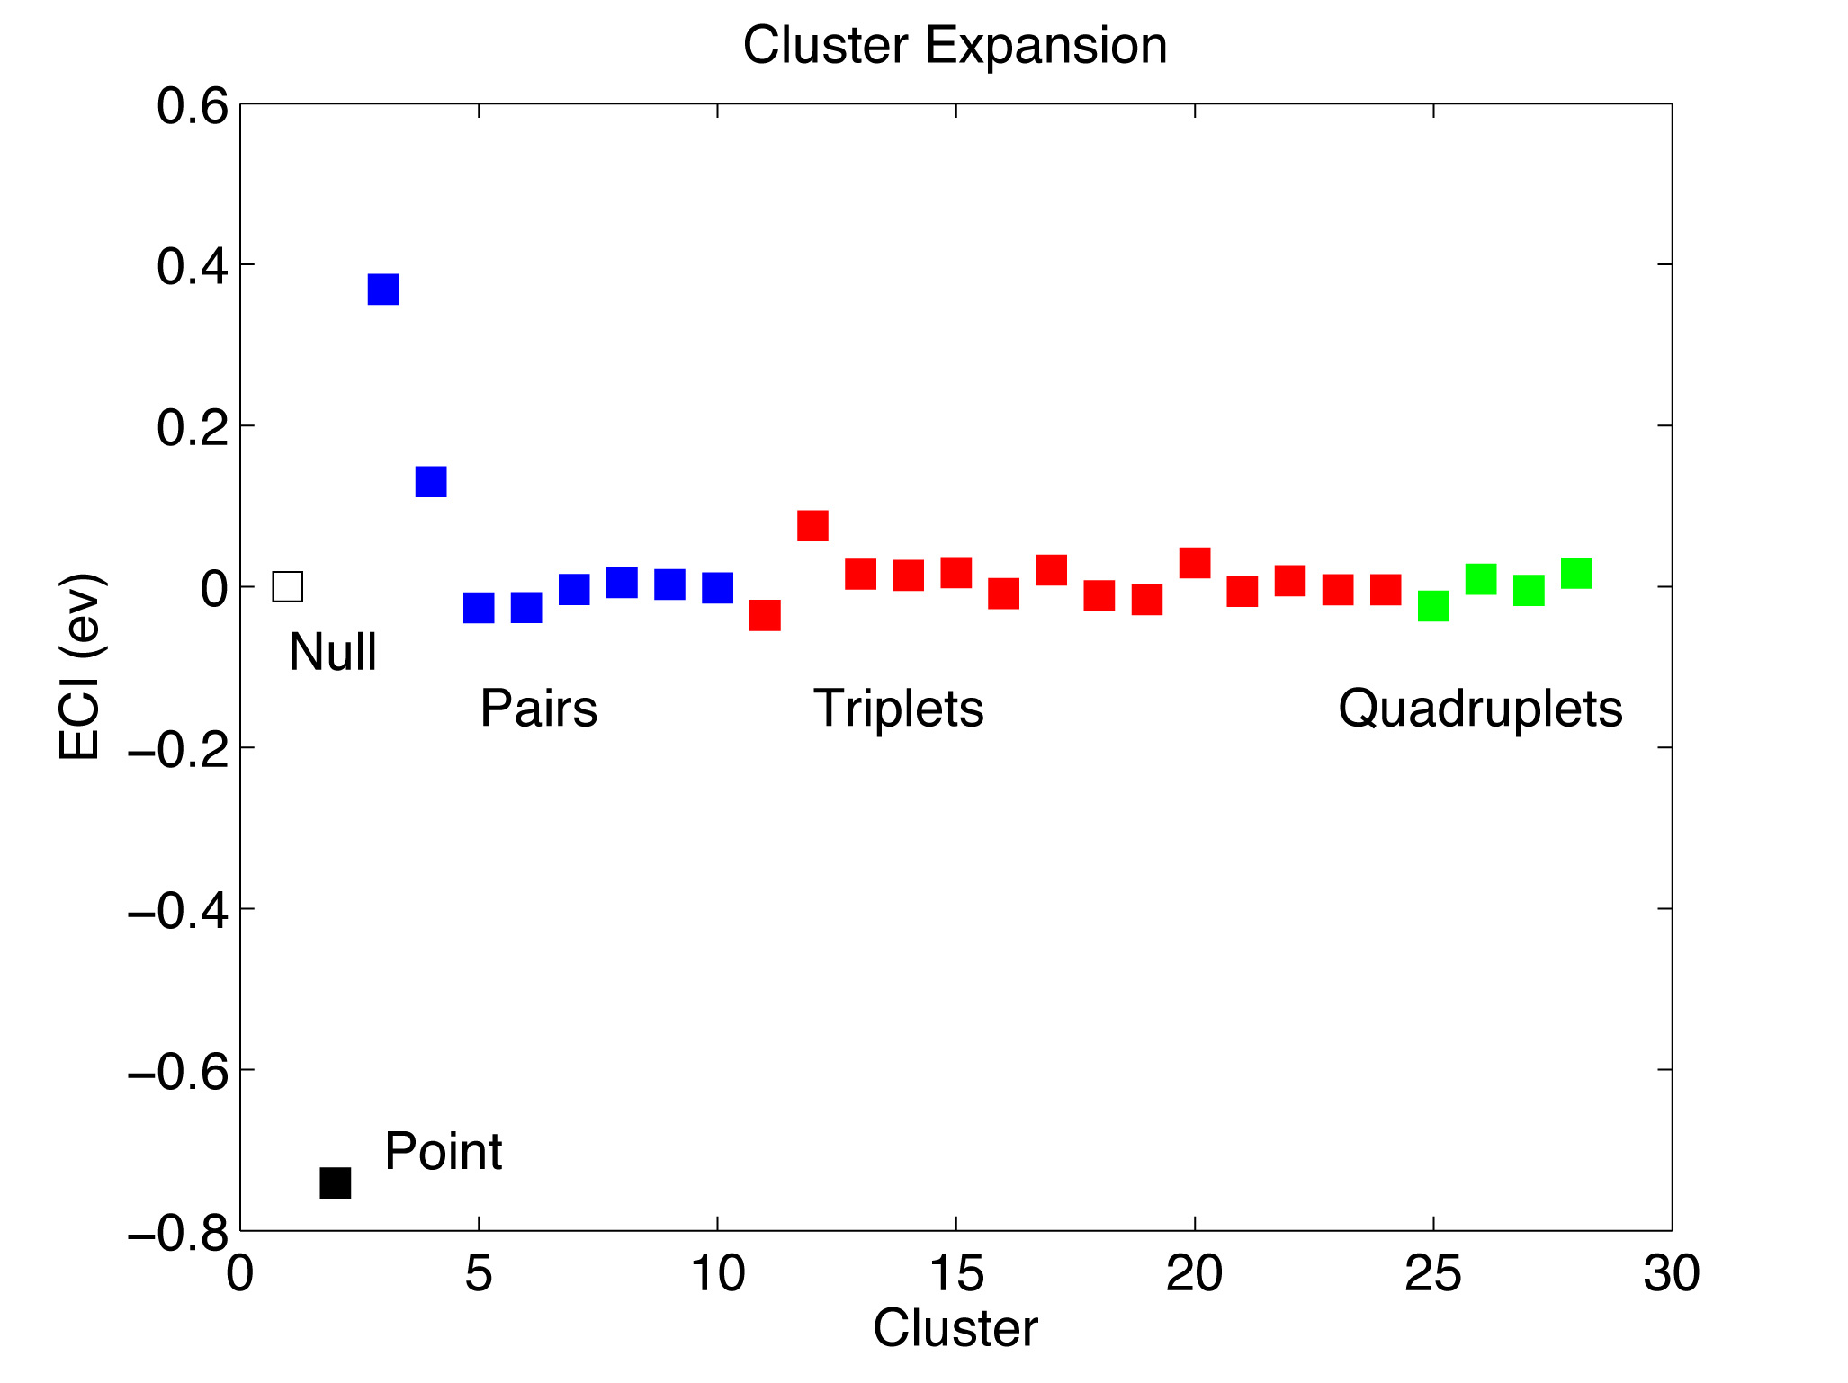
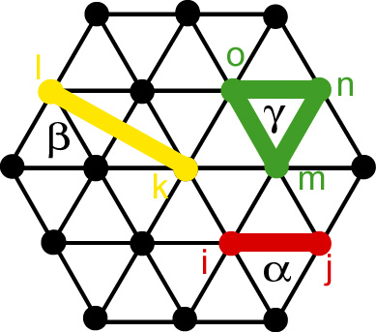
Cluster expansion for hcp Zr-O

Slide 105
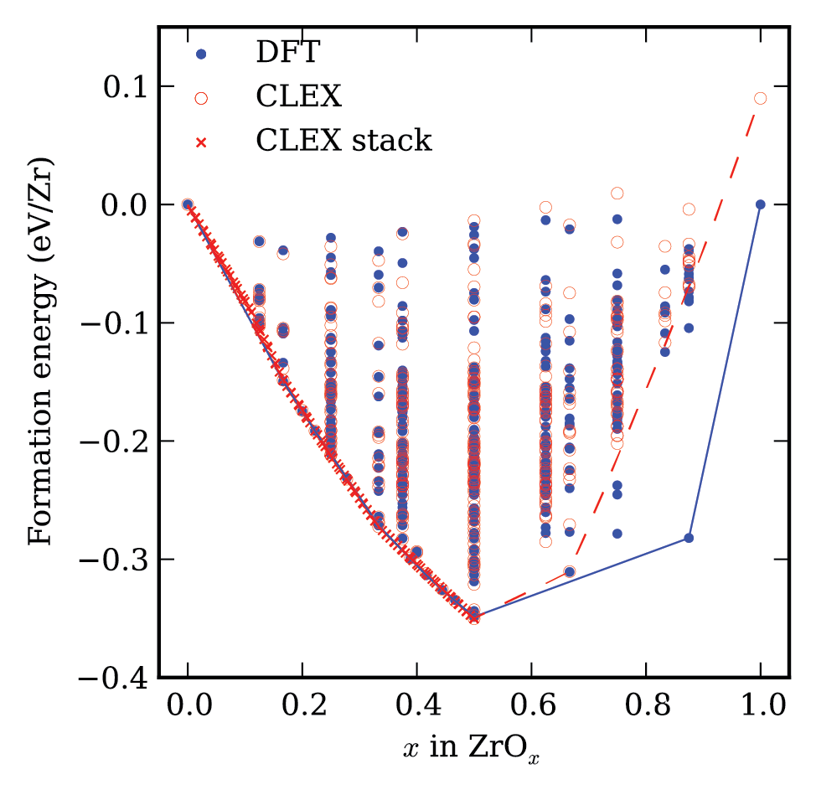
Cluster expansion for hcp Zr-O
Puchala and Van der Ven, Phys. Rev. B 88 094108 (2013).

Slide 106
CASM: Clusters Approach to Statistical Mechanics
First-principles energies of a “few” excitations
Extrapolate to
all other excitations
Lattice Model Hamiltonian
Monte Carlo
Thermodynamics

Slide 107
Summary
Crystal structure identification & specification
Symmetry analysis
Using CASM to manage data
Configuration selections and query syntax
Maintaining sanity with cluster expansion profiles
Cluster expansion basics
Configuration enumeration
Cluster expansion basis sets & correlation evaluation
Tomorrow (with Brian Puchala):
Parameterizing cluster expansions
Predicting thermodynamic properties with grand canonical Monte Carlo
Free energy integration and phase diagram construction

